Slide 1

ACCMA- Educational Partnership Overview
Jim Forsythe, Outreach Representative
Columbia Southern University
Jim.Forsythe@columbiasouthern.edu . 800.977.8449 x 1316
Notes:
Background and how the partnership evolved.

Slide 2
Eligibility
Employees of ACCMA members
ACCMA Member Cities and Counties
  All department of the membership are eligible to participate in the partnership program and a group tuition rate.
Immediate Family members of ACCMA Employees, Member Municipalities, and County Governments also qualify for the Partnership Benefits.

Slide 3
ACCMA- Learning Partnership Benefits
Group Tuition Rate
Complimentary Evaluation of Prior Academic Credits
Textbooks Included at No Cost
Exclusive Scholarship Opportunities
No Application Fees
Math & Writing Assistance
Career Services Available
Flexible Start Dates
Notes:
Give background of the LMA partnership and how it evolved.

Slide 4

Tuition & Financing
Pay As You Learn
  Using scheduled, automatic credit card payments, tuition is spread out over weekly, biweekly or monthly payments.
Military Tuition Benefits
  Active-duty military personnel and veterans have access to government programs that provide educational benefits to allow you to pursue career ambitions.
Federal Financial Aid
  For those seeking financial assistance, Federal Student Aid offers federal grant and loan programs administered by the U.S. Department of Education

Slide 5
University Overview
Founded in 1993
Flexible Online Degree Programs
28,000 Active Students
Subsidiary of Columbia Southern Education Group

Slide 6



Accreditation & State Authorization
Distance Education Accreditation Commission
Recognized by the Council of Higher Education Accreditation
Institutional Member of the American Council on Education

Slide 7
Why CSU
At Columbia Southern University, technology brings the classroom to you and our online degree programs give you the freedom to pursue your dreams, on your own terms, at your own pace, while studying anywhere you choose.

Slide 8

Scholarships
Learning Partnership Scholarship
  The scholarship will cover up to $12,600 in one online degree program. The scholarship will be applied directly to the recipient’s tuition for up to three years or until the completion of the selected online degree program, whichever comes first.

Slide 9
Additional Scholarships
Fire Scholarships
  Fire, IAFF, National Fallen Fire Fighter, NVFC, iWomen
Criminal Justice Scholarships
  National Association of Women Law Enforcement Executives
OSH Scholarships
  Safety Scholarship
Business Scholarships
  Human Resource Scholarship
Knights Scholarship
Forever A Hero Scholarship
* Please check the CSU Scholarship page for eligibility and application periods.

Slide 10
Degree Programs Offered
Associate Degrees
  General Studies
  Business
  Criminal Justice
  Fire Science
  Health Information Science
  Occupational Safety and Health

Slide 11
Bachelor Degrees
  Business Administration
    Finance
    Hospitality & Tourism
    Human Resource Management
    Information Technology
    International Management
    Marketing
    Project Management
    Sports Management
  Health Care Administration
    Emergency Medical Services Management
  Criminal Justice Administration
    Arson Investigation
Emergency Medical Service Administration
Fire Administration
  Fire Investigation
Human Resource Management
Homeland Security
  Homeland Security
Information Systems Security
Information Technology
Occupational Safety & Health
  Fire Sciences
Organizational Leadership
Psychology

Slide 12
Master Degrees
Business Administration
  Finance
  Health Care Management
  Human Resource Management
  Marketing
  Project Management
  Public Administration
Criminal Justice Administration
Emergency Services Management
Occupational Safety & Health
  Environmental Management
Organizational Leadership
Public Administration
  Criminal Justice Administration
  Emergency Service Management
Public Health
  Community Health Education

Slide 13
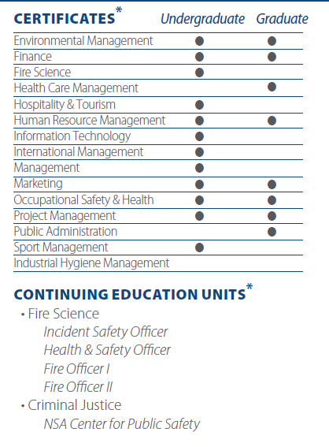
Certificates & Continuing Education

Slide 14
Flexible Enrollment Options
Term Enrollment
  You have flexibility on when to study with a structured framework for weekly assignments, and know the exact end date of your course.
LifePace Learning
  LifePace Learning® is designed to complement your individual learning pace. It offers flexible start dates, due dates and course lengths.
Veterans Advantage
  If you are using VA educational benefits, Veterans Advantage provides courses that follow defined start and end dates but have more flexibility because of fewer submission deadlines.

Slide 15
Your Next Step
We are here to meet your needs! We can assist you in promoting these education benefits for your members by:
Providing Promotional Items for Education & Employee Benefits Fairs
Being Available for Requested Visits or Webinar Presentations
Offering Informational Materials that can be distributed to employees

Slide 16
Questions & Contact Information
To learn more about our ONLINE DEGREE PROGRAMS, contact one of your partnership representatives today!
Jim Forsythe
800.977.8449 x 1316
Jim.Forsythe@ColumbiaSouthern.edu
Christie Ball
251-923-4339 (Direct)
Christie.Ball@ColumbiaSouthern.edu

Slide 17


